Slide 1
GPP Exam: Zombie AI
Aaron Van Sichem De Combe 2DAE19

Slide 2
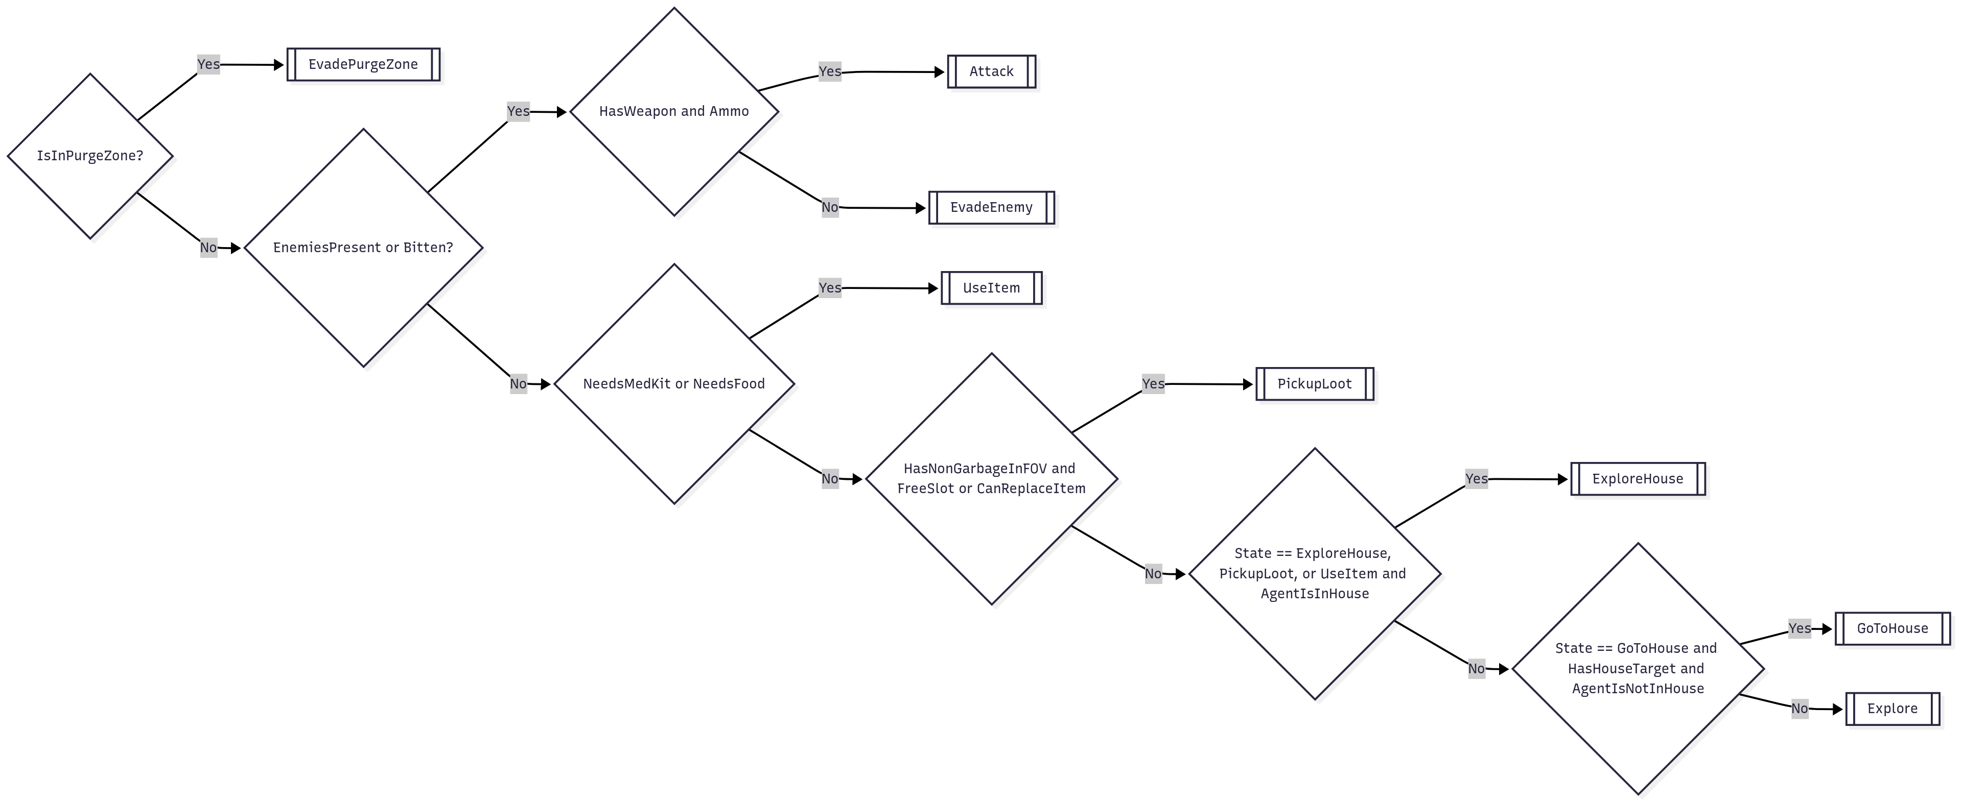
Decision Making

Slide 3
Enemy handling
When bitten -> full 360 scan -> if in FOV -> Aim -> Shoot If in FOV -> Aim Shoot No Weapons/Ammo -> Run opposite direction

Slide 4
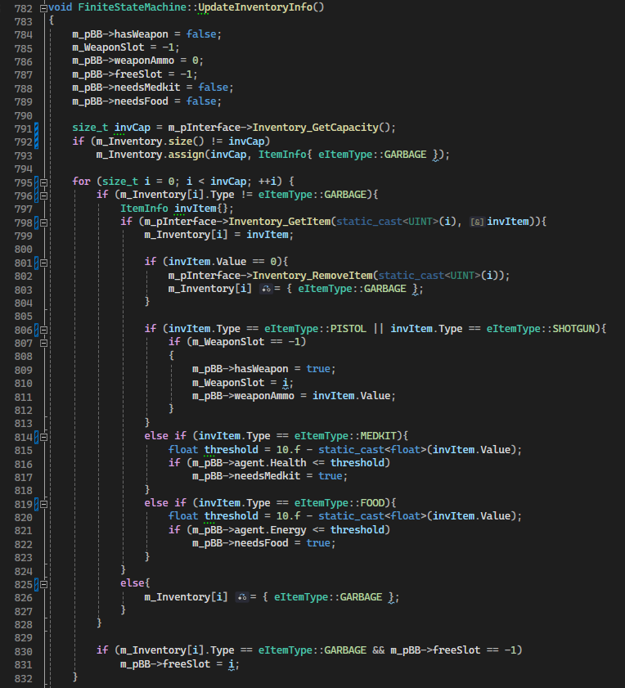
Inventory

Slide 5
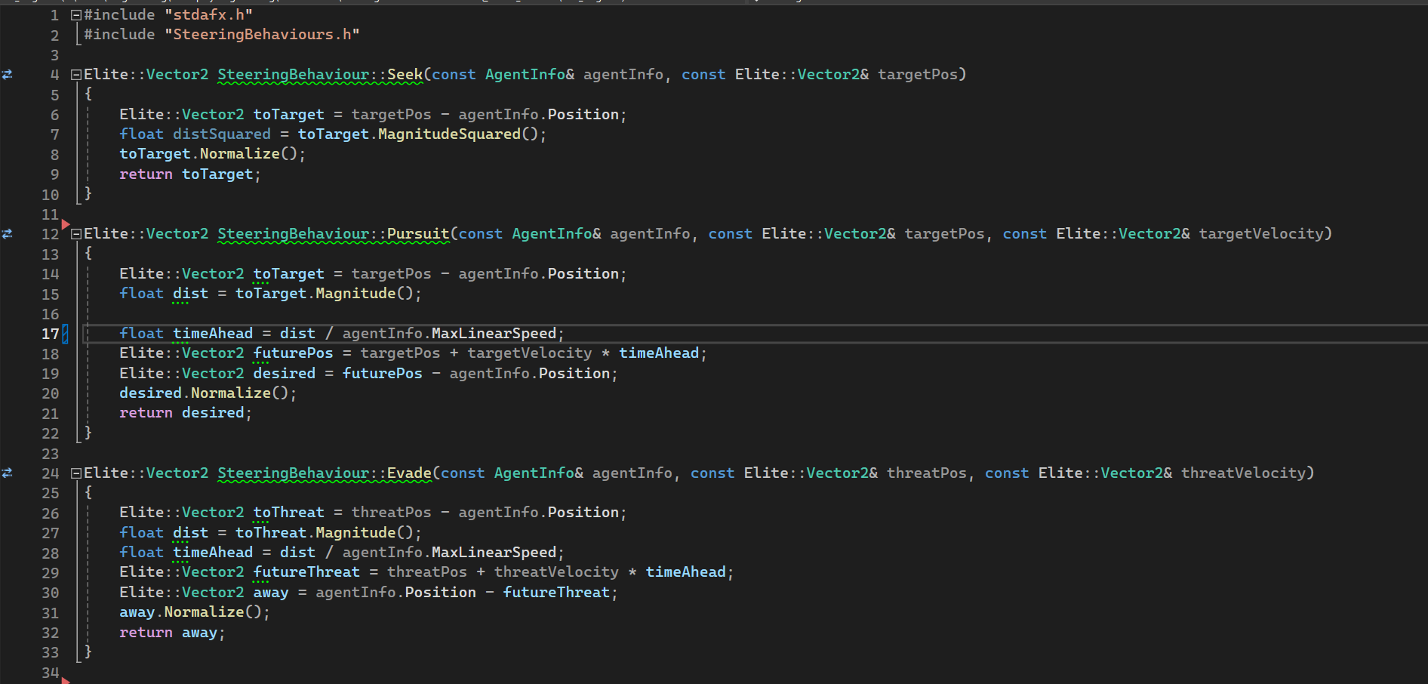
Movement - Steering

Slide 6
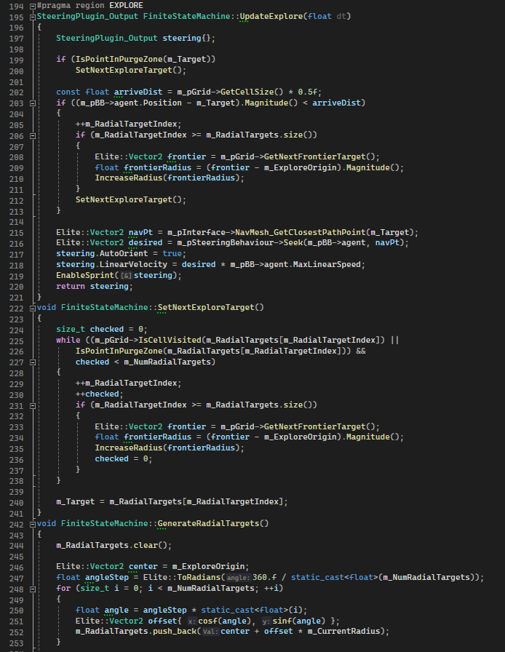
Movement - Exploration

Slide 7
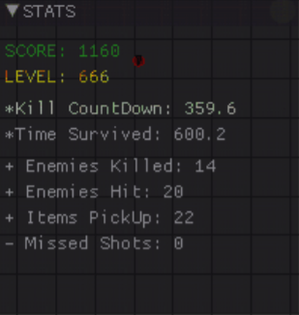
High Score

